Slide 1


Steps needed to Trust Their Data
Insight: Provide AMS insights to see what areas of their data needed to be addressed.
Recommendations: Based an analytical review from our insights, certain suggestions were made to provide actions needed to standardize their AMS Data Sets
Scope of Work: Apply several techniques to identify and update AMS system with best practices configurations and client records desired results
Results: Review results compared to initial data set

Slide 2
Insight
What did we find?
Top areas of data improvements that needed to be addressed include:
40+ Commissionable INACTIVE Producers applied to 2,000+ policies
2,869 polices had no producer associated
4000+ policies with no Line Commission Percentage or Estimated Revenue
No HOUSE Producer for owned business
Premium/Commission Calculations feature not enabled
Carrier record issues on both Carrier files & interface setup
Estimated Revenue was showing less than 50% of actual revenue received
Interface/Download was setup for only 2 carriers with improper configuration settings

Slide 3
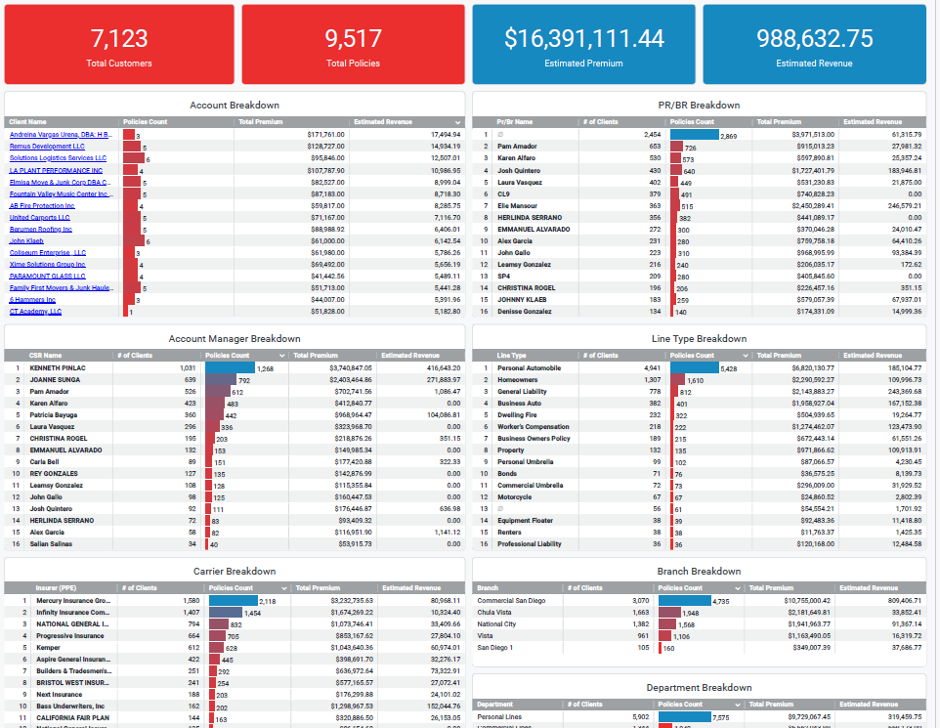
Insight
How did we locate the issues?
Applied Epic Dashboards
Applied Epic Dashboards are interactive data visualization tools within the Applied Epic platform that present business performance data in an easy-to-understand visual format, tailored to specific roles within an agency. These dashboards help users answer questions about their agency's performance and make informed decisions based on relevant data.
Here's a more detailed breakdown:
Role-Based: Dashboards are customized for different user roles (e.g., accounting, producer, account manager).
Data Visualization: They present data through graphs, charts, and other visualizations, making it easier to understand trends and patterns.
Embedded in Applied Epic: They are part of the Applied Epic system, providing a central location for data insights.
Actionable Insights: Dashboards help users identify areas for improvement, track key performance indicators, and make data-driven decisions.
Customization: Some dashboards allow for customization and the creation of custom visualizations.

Slide 4
Staff Boom Recommendations
What did we find?
Build custom Dashboard for visibility and expediting clean-up procedures
Producer Assignment Data Updates to over 4,800 lines of business
Add Line Commission Percent to 4,000 active lines
Combine all inactive commissionable producer polices into a new House employee commission agreement.
Turn on Premium/Commission Calculations
Reconfigure all interface partner carriers at the Company record and interface area
Added 150 carriers to database to properly assign correct Issuing Carriers to policies
Reconfigured all activity codes used for download of polices and eDocs
Rebuild workflow processes to better manage migration data problems

Slide 5

Our Process
Process used to approach these problems

Slide 6
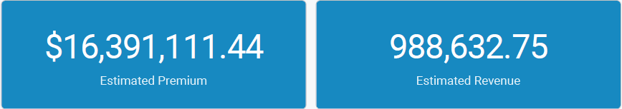
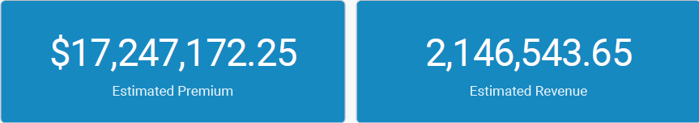
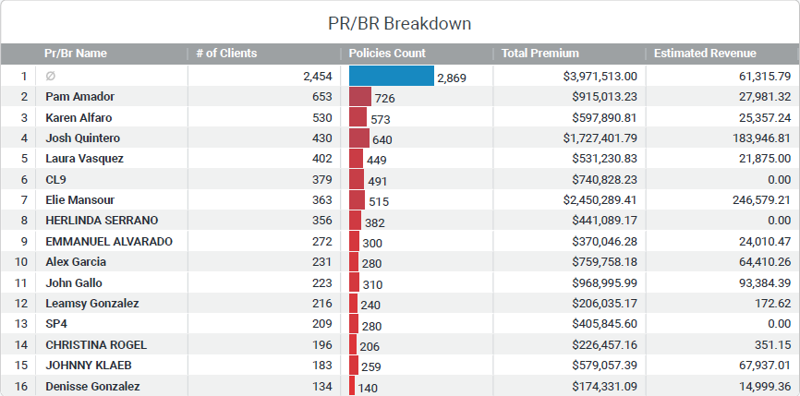
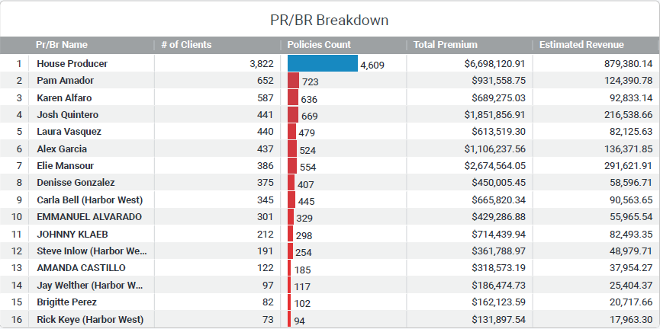
Results that matter
Day 1 Dashboard vs. Day 2 Dashboard

Slide 7
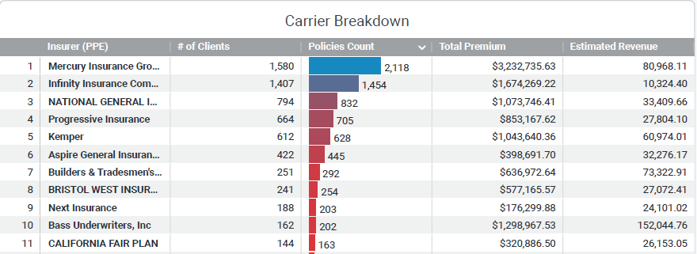
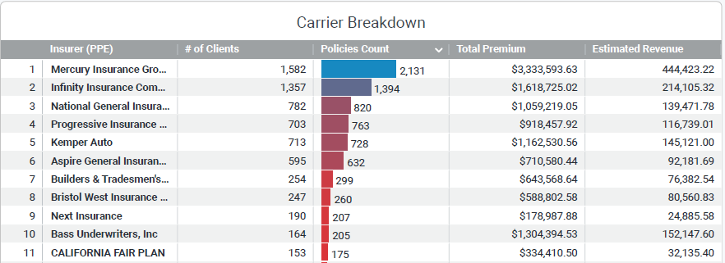
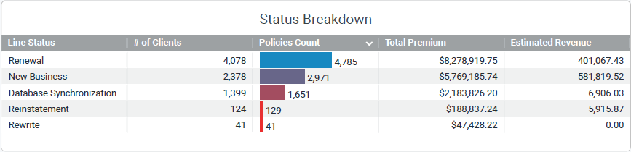
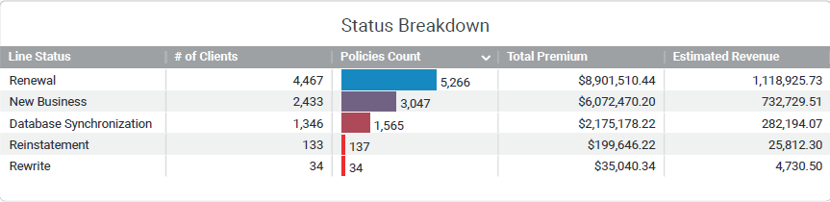
Results that matter
Day 1 Dashboard vs. Day 2 Dashboard

